Slide 1
Session : Memory Management in C and Concept of Process
Session Speaker :
Syed Hazeera
hazeeraece@gmail.com

Slide 2
Session Objectives
To understand about memory management in C.
Process.

Slide 3
Memory management in C
Memory is organized into number of segments on loading a C program. Here program may be a text editor, a compiler or an audio player etc.
These segments are:
1. Stack segment
2. Heap segment
3. Initialized global segment (Data segment)
4. Un-initialized global segment (BSS segment)
5. Text segment (Code segment)

Slide 4
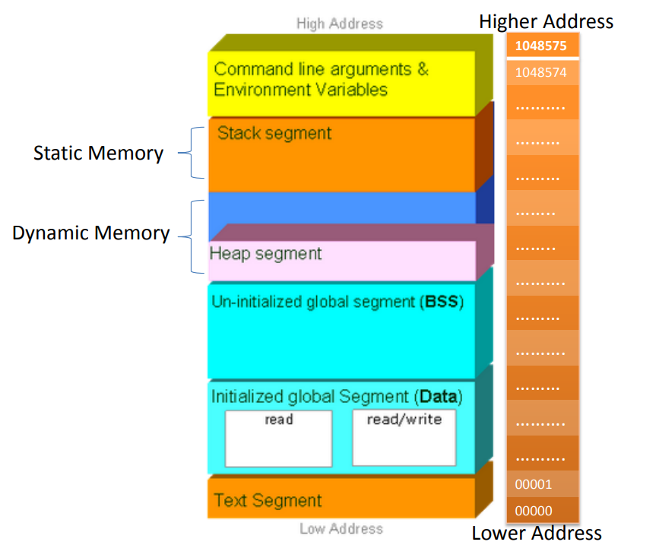
Memory management in C

Slide 5
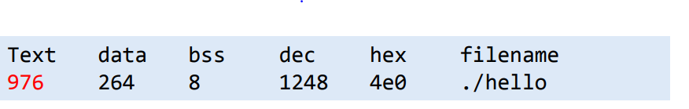
Text Segment
The program loaded to execute is stored in the text segment, which is also called code segment.
It is sharable and a copy of it is loaded into the memory can be used by any number of applications.
Contains Information about program counter and contents of processor register.
Using size command in Linux we can check the size of a c program.
Example:
$size ./hello

Slide 6
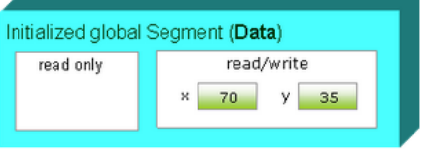
Initialized global segment/data segment
static and global variables, which are initialized by the programmer are stored in read/write portion of Data segment and their values can be changed in the program.
Example:
#include<stdio.h>
int y=25; /* initialized global variable */
int main()
{
static int x=45; /* initialized static variable */
x=x+25;
printf("x=%d",x);
y=y+10;
printf("\ny=%d",y);
return 0;
}

Slide 7
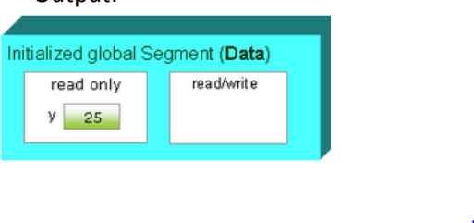
Initialized global segment/data segment
static and global variables defined as const variables are stored in the read-only section of Data segment and initialized values of these variables can’t be changed.
#include<stdio.h>
const int y=25; /* initialized constant global variable */
int main()
{
y=y+10; /* error: assignment of read-only variable ‘y’ */
printf("\ny=%d",y);
return 0;
}

Slide 8
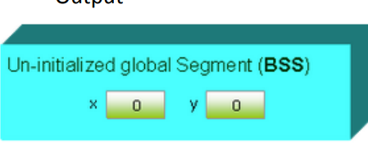
Uninitialized global segment
All the static and global variables, which are not initialized by the programmer are stored in this segment.
#include<stdio.h>
int y; /* uninitialized global variable */
int main()
{
static int x; /* uninitialized static variable */
printf("x=%d",x);
printf("\ny=%d",y);
return 0;
}

Slide 9
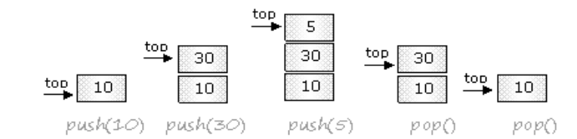
Stack Segment
Stack segment is used to store temporary data like functions, parameters and local variables.
it works on LIFO principle, push and pop operations are performed here.
Example:
Stack grows as the number of functions called is increased.

Slide 10
Stack Segment
What happens when a function is called?
The address of the instruction next to the function call is pushed onto the stack.
Space is selected on the stack for the function’s return type it is just a placeholder and CPU jumps to the function definitions.
Now, the current top of the stack is held in a special pointer called the stack frame. Everything added to the stack after this point is considered local to the function and all function arguments are placed on the stack then the instructions inside the function are executed.

Slide 11
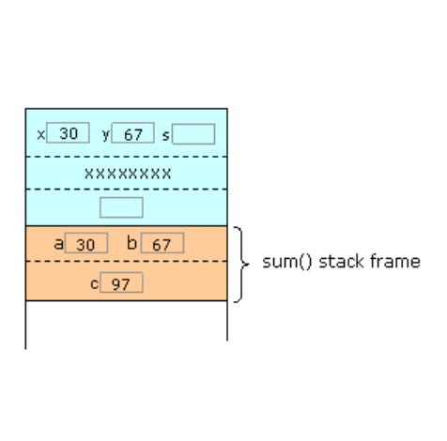
#include<stdio.h>
int sum(int,int);
int main()
{
int x,y,s;
x=30,y=67;
s=sum(x,y);
printf("Sum of two numbers %d",s);
return 0;
}
int sum(int a,int b)
{
int c;
c=a+b;
return c

Slide 12
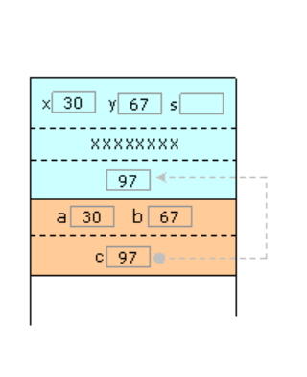
Stack Segment
What happens when a function is terminated?
The function’s return value is copied into the placeholder
Everything after the stack frame pointer is popped off. This destroys all local variables and arguments.
If no assignment takes place, and the value is lost.

Slide 13
Heap Segment
Heap is the where dynamic memory allocation takes place during run time.
Allocating and de-allocating memory during the execution of program (runtime) dynamic memory allocation is used.
malloc() – used to allocate memory dynamically .
realloc() – used to change the size of memory block.
calloc() – used to allocate multiple blocks of memory.
free()-used to release the memory space allocated dynamically.

Slide 14
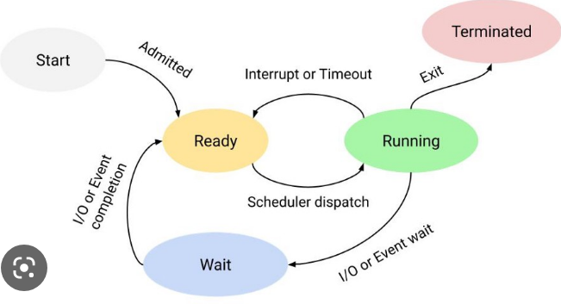
Process
Process – A process is a program in execution, which performs all tasks mentioned in program.
Each process has a state.
start – created
ready – assigned to processor
Running- executed
Wait-some event to occur
Terminated-finish execution

Slide 15
Process
Process control blocks: data structure maintained by OS for every process and each process information is stored in PCB.
PCB keeps all the information needed to keep track of the process.
It contains: process state, process privilege's, process ID, pointer, program counter, CPU register, CPU scheduling, memory management information, accounting information and i/o status information.

Slide 17
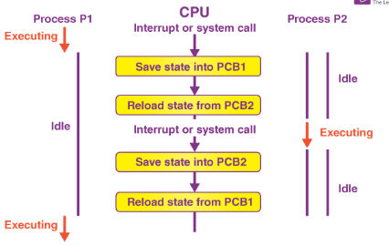
Process
Context switching : method used by the OS to switch processes from a given state to another one for the execution of its function.
In time sharing systems ,many processes
are running concurrently, it occurs many
many times each second .

Slide 18
Inter process communication
Exchange of data between two or more separate and independent process.
IPC done by 2 ways 1.unicast IPC and 2. Multi cast IPC
Unicast IPC : Communication from one process to single other process.
example: socket communiation
Multi cast IPC: Communication from one process to group of process.
example: subscribe

